Slide 1
Interaction Styles
19SW117s

Slide 2
Interaction Styles
Interaction styles are the way through which humans interact with the computer through an interface.
There are basically two high level of interactions: Physical and Conceptual.
Physical Interactions are possible through interaction devices, whereas conceptual interactions are possible through interaction styles.

Slide 3
Common Interaction Styles
Graphical User Interface
Command Line Interface
Menu Based Interfaces
Question and Answer Dialogue
Form Based Interfaces
Natural Language

Slide 4
Graphical User Interface
The graphical user interface (GUI) is a human-computer interface that uses graphical icons, menus, and windows to represent information and action to the user.
They are intuitive and user-friendly and have revolutionized human and computer interaction.
They usually use keyboard, mouse and such devices to accept input.
Examples: Microsoft Word, Windows XP, etc

Slide 5
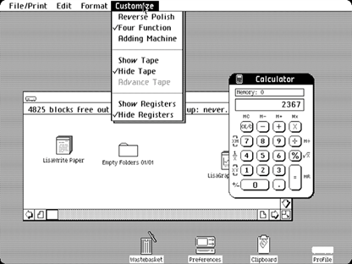
Graphical User Interface

Slide 6
Command Line Interface
A Command Line Interface displays a prompt, the user types a command on the keyboard, the computer executes the command and provides textual output.
It is also good for expert users,
It requires the user to learn complex commands or languages and it is not very good for novice users.
Example: Command Prompt

Slide 7
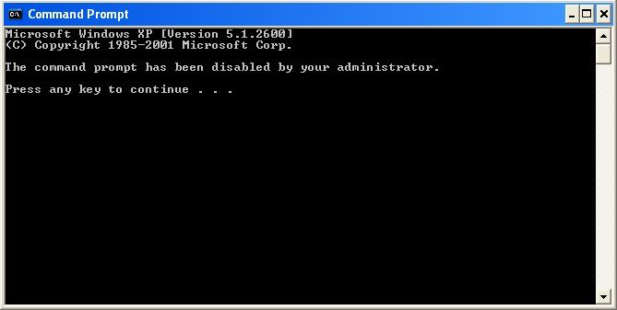
Command Line Interface

Slide 8
Menu Based Interfaces
The user has a list of items to choose from, and can make selections by highlighting one.
With this interaction style, there is no need to learn complex commands/languages.
Hence, it is easier for a novice users to learn/use.
It is ideal when there are a limited number of options (efficient)
Only disadvantage is that it can be frustrating for experienced users sometimes and the user interface may be limited by screen space and number of options available
Examples: ATM is the best example of menu based interface.

Slide 9
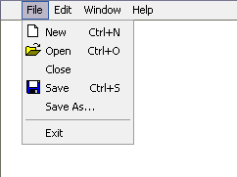
Menu Based Interface

Slide 10
Question and Answer Based Interface
In a question-and-answer interface, the computer displays a question to the user on the display.
To interact, the user enters an answer (via a keyboard stroke or a mouse click), and the computer then acts on that input information in a preprogrammed manner, typically by moving to the next question.
Examples: Cancel QnA Dialog Box, Confirm Save Box etc

Slide 11
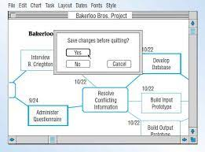
Question and Answer Based Interface

Slide 12
Form Based Interface
Form-fill interfaces consist of onscreen forms or Web-based forms.
These interfaces display fields containing data items or parameters that need to be communicated to the user.
This interface technique is also known as a form-based method and input/output forms.
Examples: Google Docs Form, MUET Admission Form etc

Slide 13
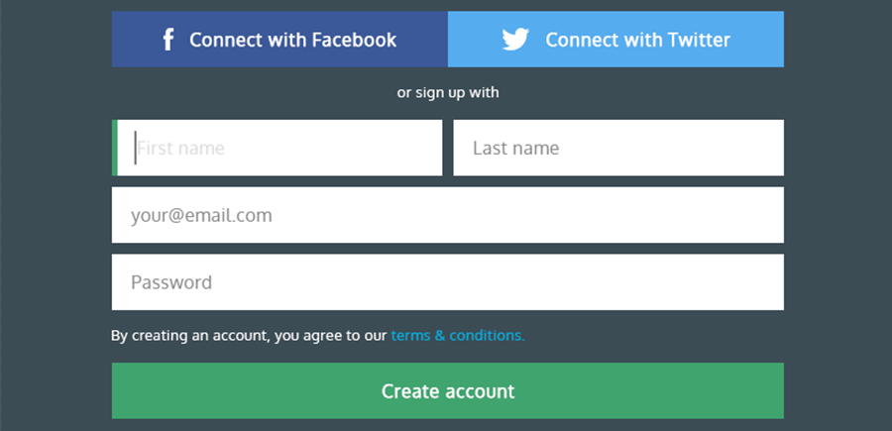
Form Based Interface

Slide 14
Natural Language
Natural Language is an interaction style which allows the user to communicate with their computer through a series of spoken commands.
Natural Language Interface is that there is no any special skill required from user who interacts with the computer using natural language.
Examples: Siri, Alexa, Google Voice Assistant etc

Slide 15
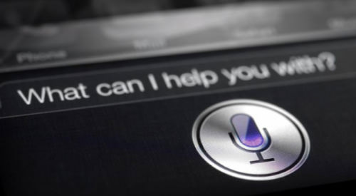
Natural Language

Slide 16
Thanks

